Slide 1
Chain Replication
Presented by Zhao Yuxuan

Slide 2
<<Chain Replication for Supporting High Throughput and Availability>>
--OSDi 2004
Chain replication is a new approach to coordinating clusters of fail-stop storage servers. The approach is intended for supporting large-scale storage services that exhibit high throughput and availability without sacrificing strong consistency guarantees.

Slide 3
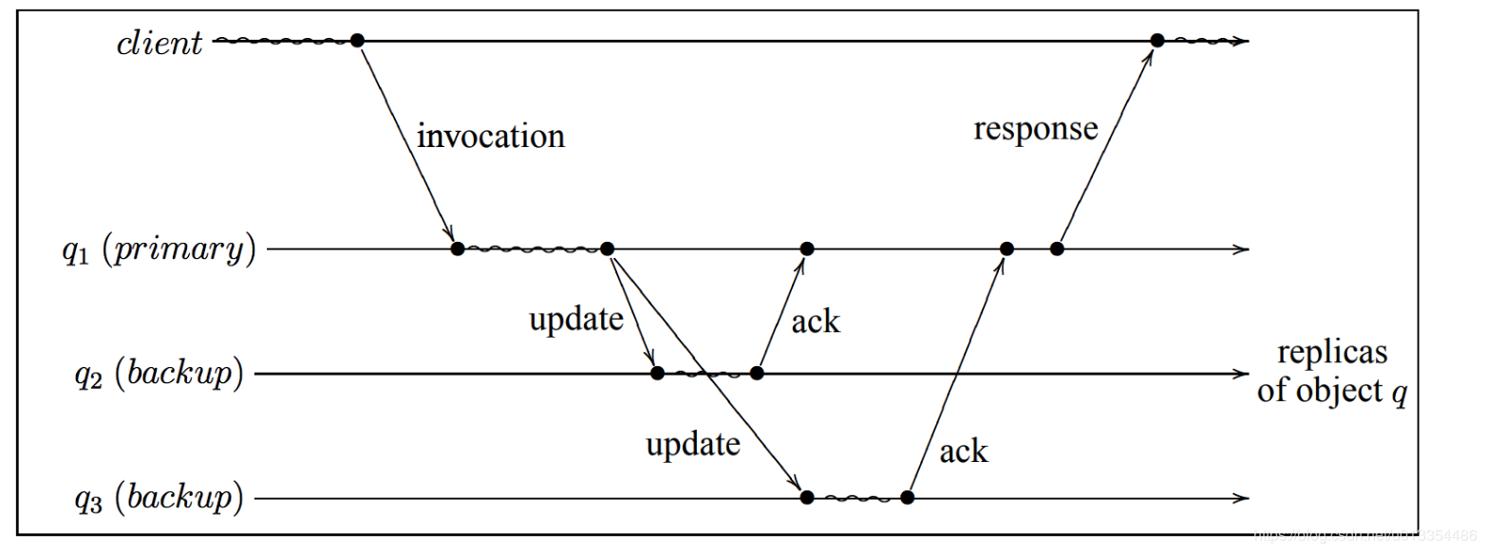
Primary/Backup
P/B is the most popular approach to our problem. P/B has one primary server, N backup servers.

Slide 4
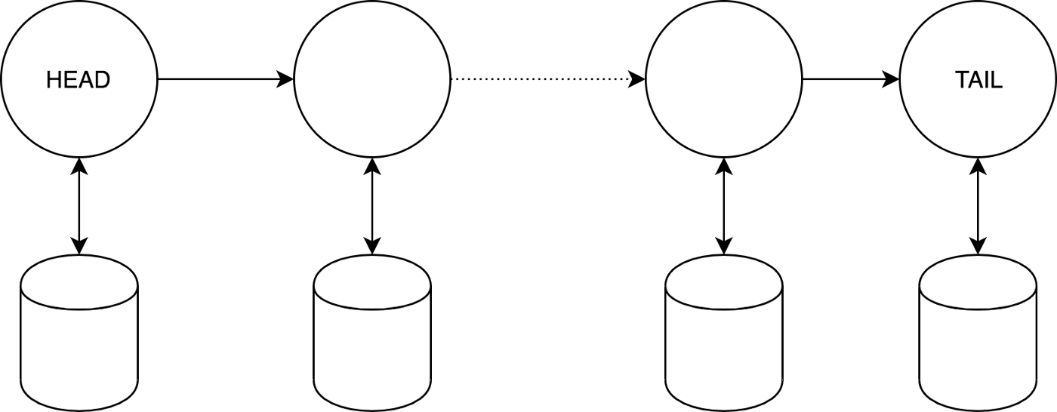
Chain Replication
Basic components of CR are: a sequence (chain) of nodes with 2 special nodes — HEAD (receives requests from clients) and TAIL (end of the chain, provides the guarantee for consistency).

Slide 5
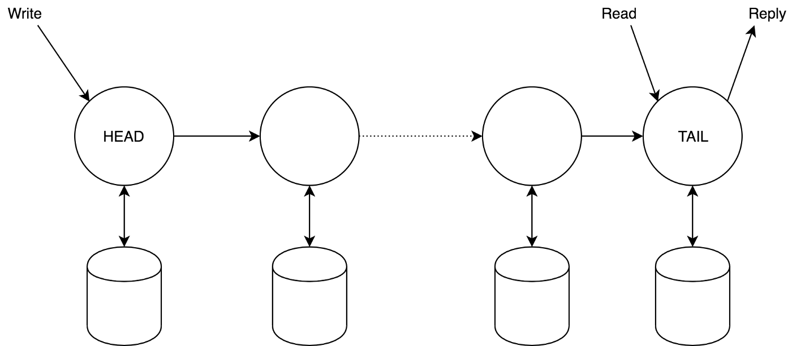
Chain Replication-basic approach
Clients send write requests to the head and read requests to the tail. The response always comes from the tail

Slide 6

Replication protocol
1.Pending(i) — list of received requests by not yet processed by the tail.
2.Sent(i) — list of not yet processed by the tail requests, sent to the node’s i successor.
3.History(i, key) — list of changes for the key. It could be either full history or just last value.

Slide 7
Coping with failures
As it has been already mentioned we need a special master process, which will:
Detect a failed node.
Notify predecessor and successor of the failed node.
Notify clients if the failed node is either head or tail.

Slide 8
Possible failures
Failure of the head.
Failure of the tail.
Failure of another node k.

Slide 9
Comparison with primary/backup approach
1.Read requests are served by only one node in CR and are responded immediately, whereas in P/B there could be a delay on the Primary node to receive write confirmations from all backups.
2. Write request is executed on all nodes in both approaches, however, it is a bit faster in P/B due to the parallel execution.

Slide 10
Thank you

